Slide 1




MicroProfile 4.0
December 23rd, 2020
MicroProfile Community
Notes:
TODO

Slide 2
What is MicroProfile?
MicroProfile is an open-source community specification for Enterprise Java microservices
A community of individuals, organizations, and vendors collaborating within an open source Eclipse Foundation Working Group to bring microservices to the Enterprise Java community

Slide 3
New! MicroProfile Working Group
Formed an Eclipse Working Group to close intellectual property gap
The MicroProfile Charter defines the MicroProfile Working Group vision and scope, governance, membership, and more.
MicroProfile component specifications follow the MicroProfile Specification Process, a compatible specialization of the Eclipse Specification Process.
MicroProfile 4.0 is the first release delivered under the MicroProfile Working Group
Notes:
By forming a working group, Working Group members can appy their patent portfolios to protect MicroProfile members, implementers, and users.
The Microprofile Specification process is nearly identical to the Jakarta EE Specification Process, with the exception of shortening 14-day voting periods when all members have voted, maintaining a minimum of 7 days.

Slide 4





Working Group Corporate Members
Notes:
TODO - Review logos.
John- The logos are in the drive under MPWG- Amelia

Slide 5









Current MicroProfile implementations
Notes:
TODO - review implementations

Slide 6
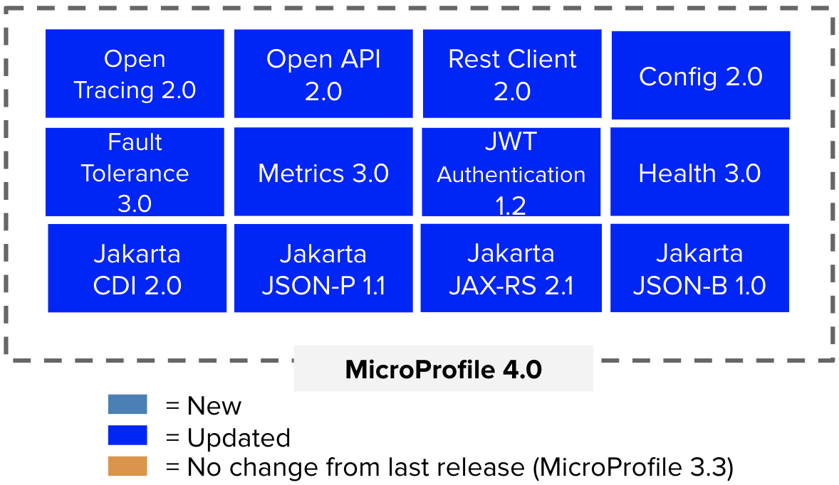
MicroProfile 4.0 Released!
Released December 23rd, 2020. Offered in the release:
First release under the MicroProfile Working Group and MicroProfile Specification Process
Updated to Jakarta CDI, JSON-P, JSON-B, and JAX-RS (that align with Jakarta EE 8, javax.* namespace)
A richer feature set for all specifications, like
Configuration profiles (dev, test, prod)
JWT 1.2 - Tokens in cookies
Release (Backwards incompatible changes)
Notes:
TODO - Fix date

Slide 7
MicroProfile 4.0 (December 2020)
Standalone
Open Tracing 2.0
Open API 2.0
Rest Client 2.0
Config 2.0
Reactive Messaging 1.0
Fault Tolerance 3.0
Metrics 3.0
JWT Authentication 1.2
Health 3.0
Reactive Streams Operators 1.0
Jakarta CDI 2.0
Jakarta JSON-P 1.1
Jakarta JAX-RS 2.1
Jakarta JSON-B 1.0
Context Propagation 1.0
GraphQL 1.0
MicroProfile 4.0
= New
= Updated
Outside umbrella
= No change from last release (MicroProfile 3.3)
Notes:
TODO - Date

Slide 8
MicroProfile Config 2.0
Provides an easy to use and flexible system for application configuration
What's new
Updated to use Jakarta EE 8 dependencies
Added bulk extraction of properties into POJO using @ConfigProperties
Added Property Expansion
Added configuration profiles (ex: dev, testing, live)
More ...
Backwards incompatible changes (more ...)
Specification release (changes)

Slide 9
MicroProfile Fault Tolerance 3.0
Defines easy to use and flexible APIs for building resilient applications.
What's new
Updated to use Jakarta EE 8 dependencies
Updated metrics to use tags
Specifies lifecycle of circuit breakers and bulkheads
More ...
Backwards Incompatible changes
Some metrics names and scope may have changed
More ...
Specification release (changes)

Slide 10
MicroProfile Health 3.0
Expose the availability of a MicroProfile runtime to underlying platform
What's new
Updated to use Jakarta EE 8 dependencies
mp.health.default.readiness.empty.response property to define default readiness on application startup
More ...
Incompatible changes
Pruning @Health qualifier (deprecated in Health 2.0)
More ...
Specification release (changes)

Slide 11
MicroProfile JWT RBAC 1.2
Using OpenID Connect(OIDC) based JSON Web Tokens(JWT) for role based access control(RBAC) of microservice endpoints.
What's new
A convenience method for retrieving claims from JsonWebToken using the Claims enum
Support JWT token cookies
More ...
Specification release (changes)

Slide 12
MicroProfile Metrics 3.0
Define custom application metrics and expose platform metrics on a standard endpoint using standard formats
What's new
Updated to use Jakarta dependencies
Timer now exposes total elapsed time duration as a metric value
New base REST metric REST.request.unmappedException.total
More ...
Incompatible changes
Removed everything related to reusability. All metrics are now reusable.
More ...
Specification release (changes)

Slide 13
MicroProfile OpenTracing 2.0
Trace request flows between service boundaries
What's new
Updated to use Jakarta dependencies
More ...
Incompatible changes
Tracer.startManual() -> Tracer.start()
Scope.span() -> ScopeManager.activeSpan()
More ...
Specification release (changes)

Slide 14
MicroProfile OpenAPI 2.0
Provides Java interfaces and programming models to natively produce OpenAPI v3 documents from JAX-RS applications
What's new
Updated to use Jakarta dependencies
Added @SchemaProperty, @RequestBodySchema, @APIResponseSchema properties
Added mp.openapi.schema MicroProfile Config property prefix
More ...
Incompatible changes
Removed interfaces marked deprecated in version 1.1
More ...
Specification release (changes)

Slide 15
MicroProfile Rest Client 2.0
Type-safe rest client defined as Java interfaces
What's new
Updated to use Jakarta dependencies
Added support for Server Sent Events
Added support for configuring HTTP proxy servers
Added support for automatically following redirect requests
More …
Incompatible changes
Removed support for Java EE 7
Specification release (changes)

Slide 16
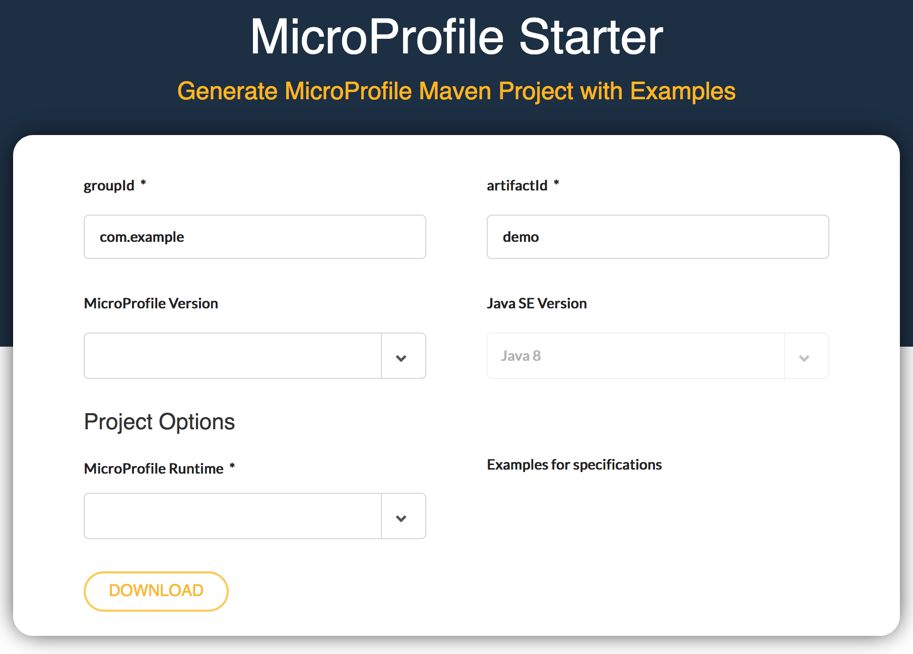
start.microprofile.io
Generate MicroProfile projects
Visual Studio Code plugin
Command line tooling

Slide 17
MicroProfile Reactive Capabilities
MicroProfile Reactive Streams Operators
A set of operators to create new reactive streams, process the transiting data and consume them with ease
MicroProfile Reactive Messaging
Defines a development model for declaring CDI beans producing, consuming and processing messages. It relies on Reactive Streams Operators and CDI
MicroProfile Context Propagation
APIs for propagating contexts across units of work that are thread-agnostic
Reactive Streams Operators 1.0.1
- Project page - Spec PDF doc - Spec HTML doc - Technology Compatibility Kit (TCK)
MicroProfile Reactive Messaging 1.0
- Project page - Spec PDF doc - Spec HTML doc - Technology Compatibility Kit (TCK)
Context Propagation 1.0.2
- Project page - Spec PDF doc - Spec HTML doc - Technology Compatibility Kit (TCK)
Standalone Specifications

Slide 18

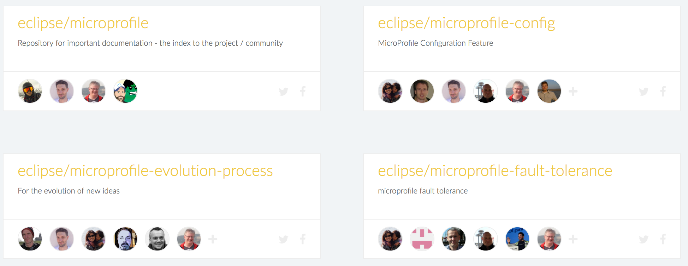



Get Involved!
Google Groups
MicroProfile Projects
Bi-Weekly & Quarterly
General community
Meetings
Video Hangouts
YouTube Channel

Slide 19
MicroProfile

